Slide 1
IS 665 - Exploratory Analysis on COVID-19
By Group Fast and Serious
Jatin Meenal Komal Pradeepti

Slide 2

Contents
COVID – 19 Global Timeline
About the Dataset
Descriptive Statistics
Exploratory Analysis

Slide 3
COVID – 19 Global Timeline
Dec - Jan
31 Dec China reported a cluster of cases of pneumonia in Wuhan
01 Jan Wuhan Seafood Market closes
Feb - Mar
Apr - May
02 Apr The world passes 1 million COVID-19 infections
11 Jan China records its first death
13 Jan First case outside of China(Thailand)
20 Jan First US case reported in Washington
30 Jan WHO declares a global public-health emergency
10 Apr The global death toll surpasses 100,000
15 Apr Number of global COVID-19 cases surpasses 2 million
22 Apr US reports the highest single-day death toll for any country: more than 2,600
01 May Roughly 3.3 million confirmed cases of COVID-19, with about 1.2 million being active and ongoing cases, roughly 1 million recoveries, and 234,000 deaths
09 Feb Death toll in China surpasses that of the 2002-2003 SARS epidemic, with 811 deaths recorded
19 Feb Iran outbreak begins
21 Feb Italy outbreak begins
11 Mar WHO characterized COVID-19 as a pandemic
23 Mar NYC confirms 21,000 cases, making it the biggest epicenter of the outbreak in the US

Slide 4

About the Dataset
168 countries included
Date range: Jan 2020 to Apr 2020
Variables in the dataset
Country
Date
Confirmed cases
Recovered cases
Deaths
Classification of the country (Developed, Underdeveloped, Developing)
Total Population
Population density
Healthcare system index ranked by WHO
Median age of people in the country
Costal / Non costal

Slide 5
Descriptive Statistics of Global cases as on 4/7/2020

Slide 6
Exploratory Analysis

Slide 7
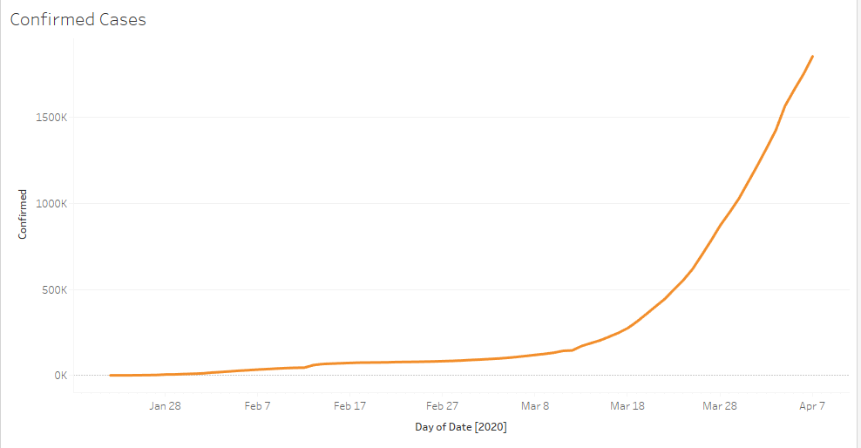
Trend of confirmed cases of COVID-19
We can see that the number of confirmed cases has been on an exponential rise post from Mar 2020.
Probable causes:
More testing
Less awareness of social distancing
Delayed shutdown in some countries

Slide 8
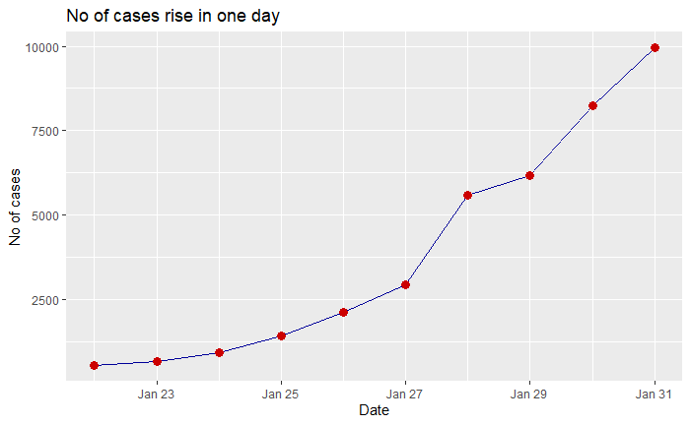
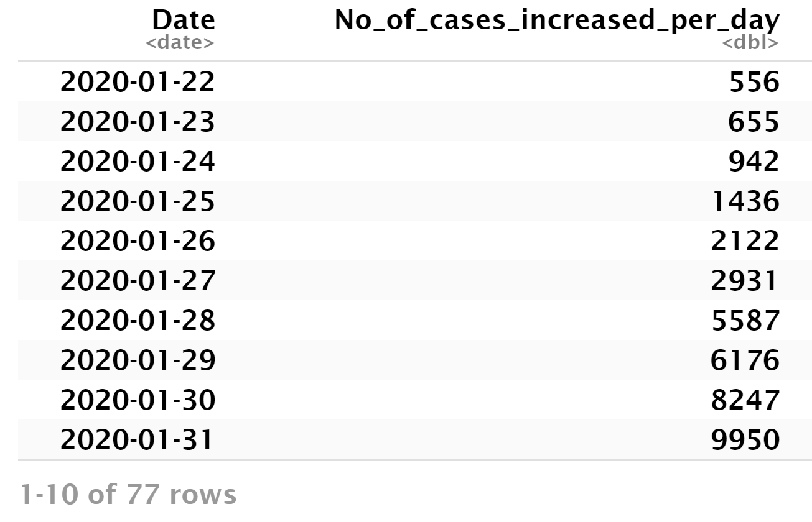
COVID – 19 Number of cases increasing per day globally
There has been a steep rise in the cases from Jan 22nd globally
Probable causes:
More International travel
Incubation period of 14 days
Lack of early preventive measures by the governments from Jan 2020

Slide 9
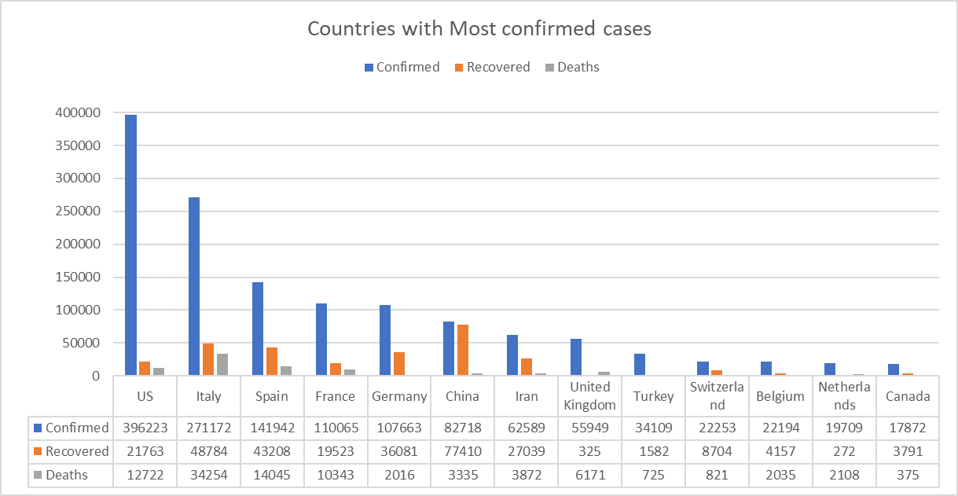
Which countries are the most affected by COVID – 19
Summary
US has the most confirmed cases, followed by Italy and Spain.
China has the most recovered cases
Italy has experienced highest deaths

Slide 10
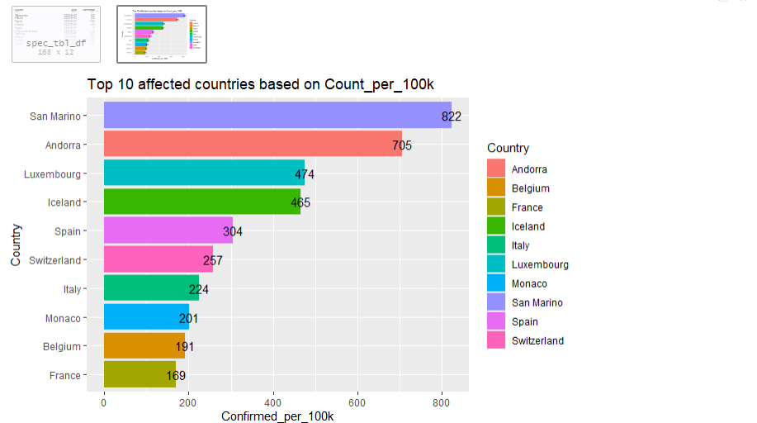
Countries with most affected cases based upon count per 100k people?

Slide 11
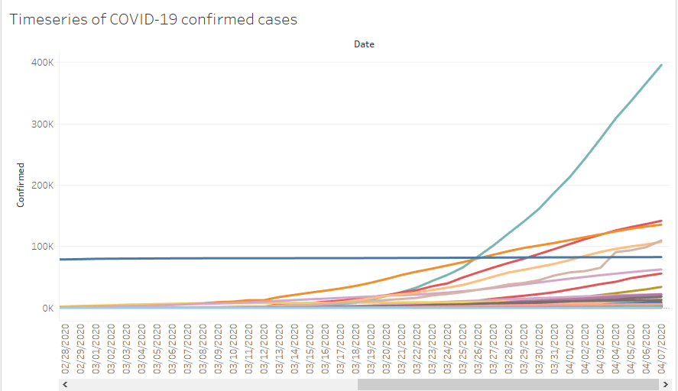
When was COVID-19 declared a pandemic and why?
The number of cases observed world wide suddenly increased from March 2020
Probable causes:
Virus was not contained in China
Fast spreading nature of the virus(respiratory and human contact)
Lack of awareness globally

Slide 12
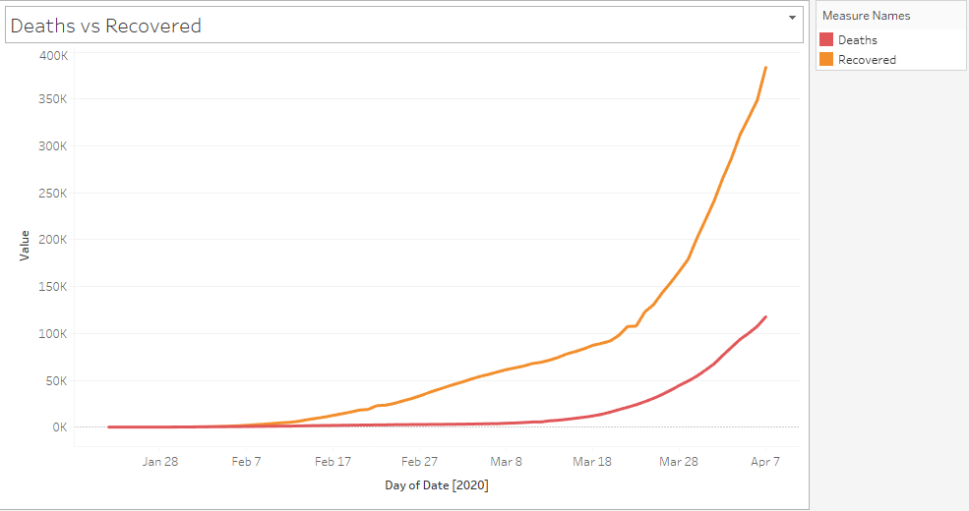
Trend of deaths vs recovered cases of COVID-19
We can see that the number of deaths and recovered cases has had an exponential rise post from Feb 2020.
Probable causes:
No vaccine available yet
Pre-existing medical conditions of the patients
The ones with good immunity and proper medical care have had recoveries.
Patient promptly getting tested as and when symptoms showed up

Slide 13
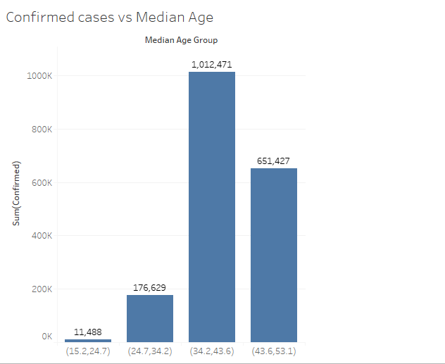
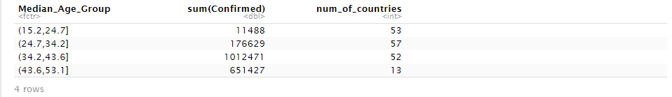
How is the age affecting the number of confirmed cases?
We can see that people of ages 34 and older are majorly affected by COVID-19.
As older people are prone to conditions such as hypertension, diabetes, cardiovascular, etc., they are at a greater risk.

Slide 14
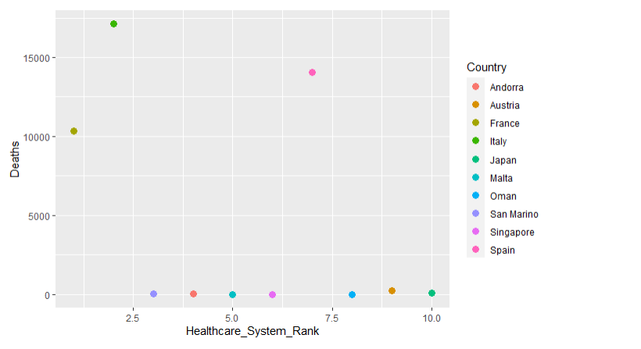
Which country has been most affected even though they have good healthcare facilities?
Summary
France, Italy and Spain are observed with the highest death rate.
Probable causes:
Older population
More tourism
Densely populated

Slide 15
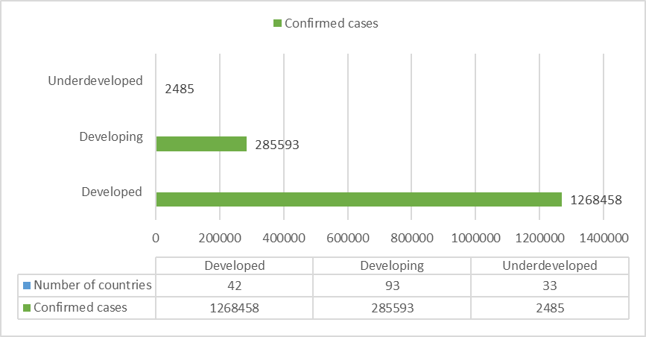
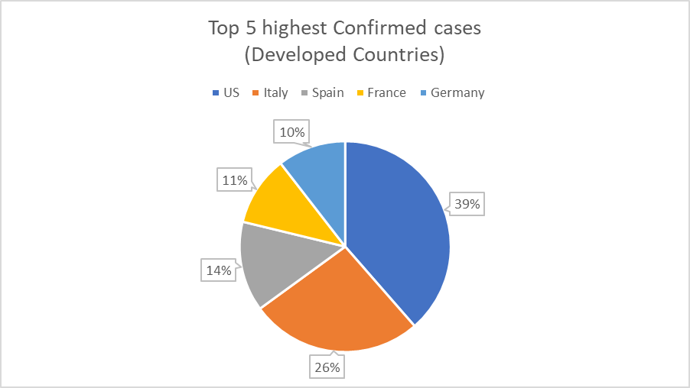
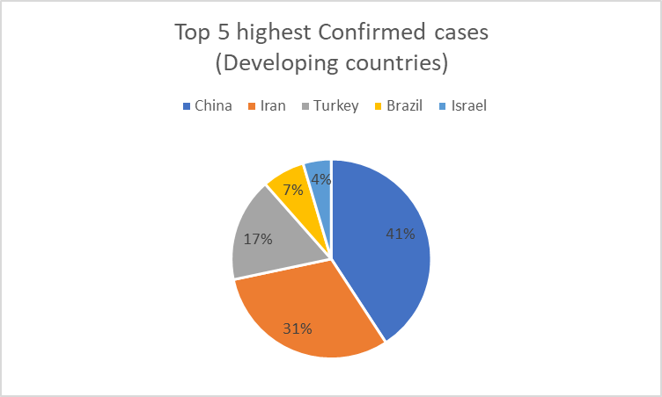
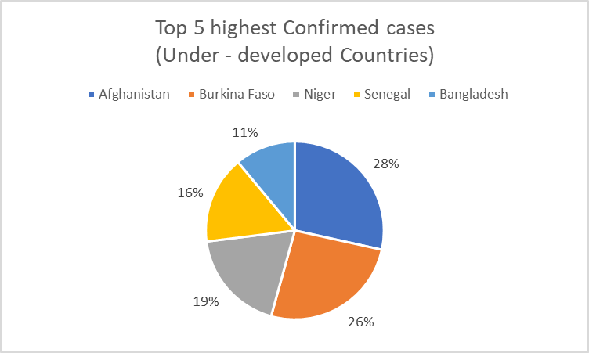
COVID – 19 confirmed cases based on development classification
US, China, Afghanistan have the most confirmed cases in the three categories respectively.
Probable causes
More international travel, tourism in countries.

Slide 16
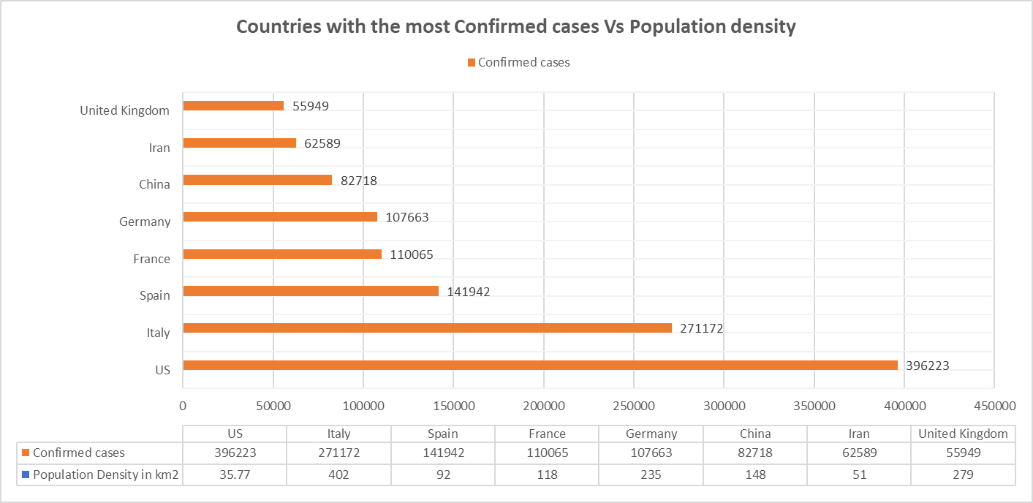
How is the Population Density of a country influencing the cases?
Summary
For a fast spreading communicable disease, we found no direct relationship between the population density and number of cases in a country.
Probable causes could include
Difficulty in practicing social distancing in densely populated cities
Lack of proper standards/measures in testing

Slide 17
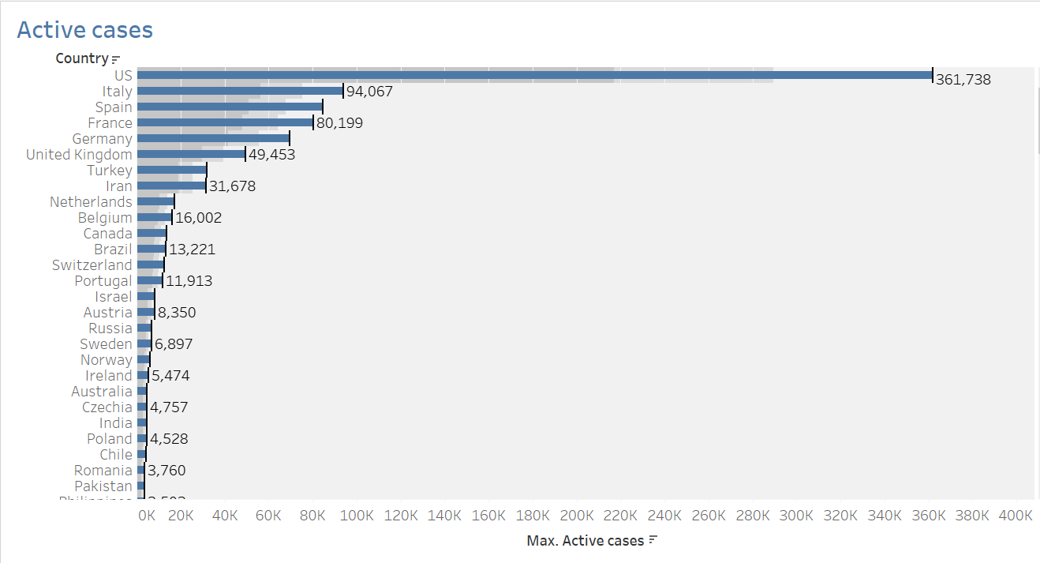
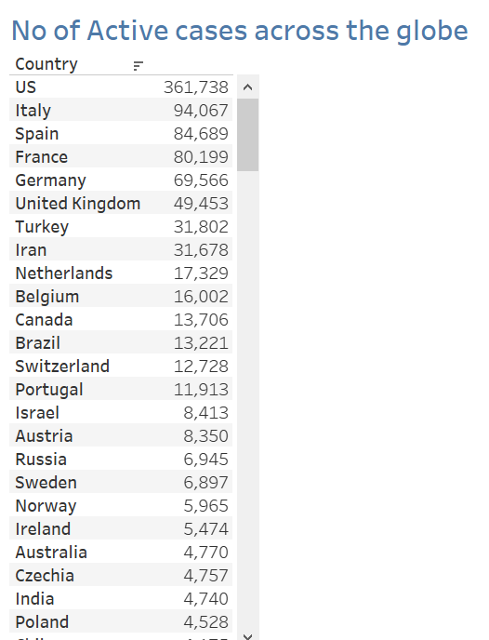
Which country has the highest number of active cases?
Active cases = Confirmed – (death+ recovered)
US has the most confirmed cases, followed by Italy and Spain.
Causes
Late shutdown
Testing at airports was not done on travelers from all the countries' airports initially
Lack of checks on travel history
Lack of necessary medical equipment and medical personnel.

Slide 18
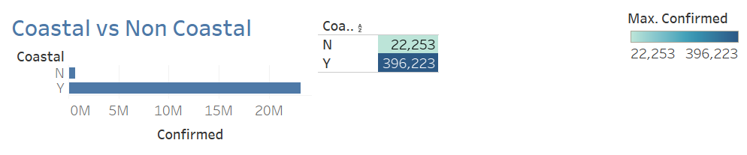
Confirmed Cases by Coastal/Noncoastal classification
Summary
Most cases were found in Coastal countries.
Causes:
Apart from airport entry there are many points of entries

Slide 19
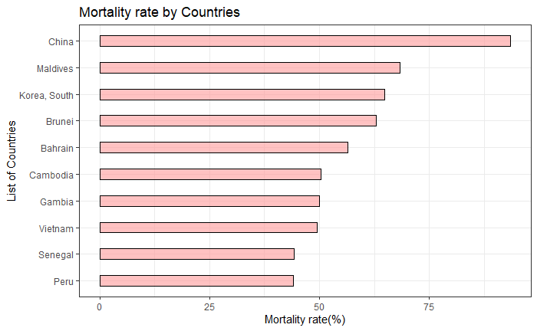
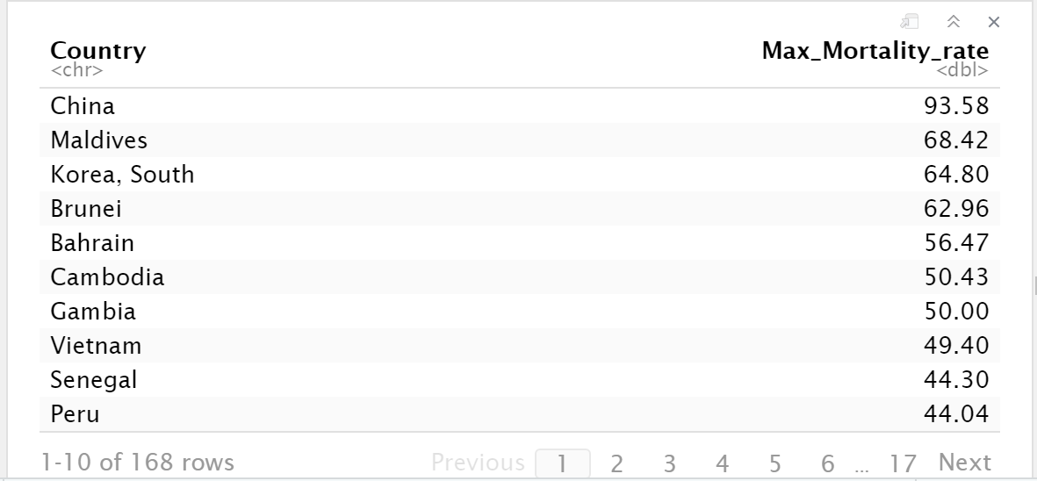
Which country has the highest mortality rate?
Mortality rate = (Recovered/confirmed)*100
Probable causes:
China has the highest recovery rate may be because of the intense lockdown and social distancing measures.

Slide 20
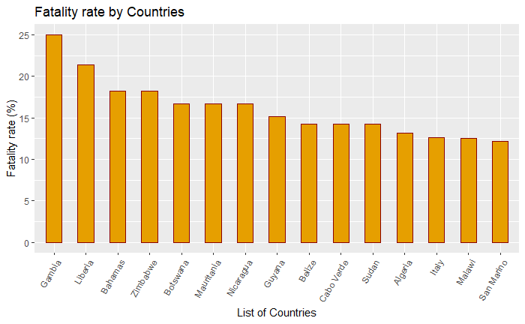
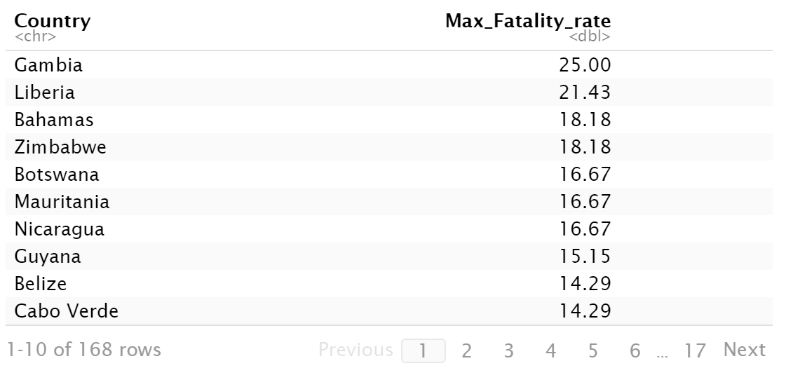
Which country has the highest fatality rate?
Fatality rate = (Death/confirmed)*100
Gambia has the highest no of death count vs confirmed count.
Probable Causes
Lack of necessary medical facilities
Lack of appropriate quarantine, isolation measures and lack of contact tracing

Slide 21
Conclusion
Developed countries have experienced the highest number of cases.
Countries with a good healthcare index are worst hit, but are trying to flatten the curve with strict lockdowns and social distancing measures.
Age is a great contributing factor. People of 34 years and older are at a higher risk. Pre-existing medical conditions can cause more complications.
Population density, surprisingly has not been a contributor for the widespread cases. Countries like US, Italy, Spain with very less Population density are the worst hit.
Coastal countries have recorded more cases than non-coastal ones.
Governments should not re-open the states/countries soon as there could be a chance of a second wave of infections.
We can learn from some countries on how to implement strict lockdown guidelines, so that we achieve good recovery rate and reduce the burden on healthcare system.

Slide 22
References
https://www.who.int/news-room/detail/27-04-2020-who-timeline---covid-19
https://www.businessinsider.com/coronavirus-pandemic-timeline-history-major-events-2020-3
https://abc7ny.com/coronavirus-travel-to-new-york-nyc-china/6084186/
https://www.aljazeera.com/news/2020/01/countries-confirmed-cases-coronavirus-200125070959786.html
Datasets source: https://github.com/datasets/covid-19/blob/master/data/countries-aggregated.csv
Country Population: https://www.worldometers.info/world-population/population-by-country/
Healthcare system rank: https://photius.com/rankings/healthranks_alpha.html
Classification:https://www.un.org/en/development/desa/policy/wesp/wesp_current/2014wesp_country_classification.pdf
Age median of countries: https://en.wikipedia.org/wiki/List_of_countries_by_median_age
Coastal/Non coastal countries : https://en.wikipedia.org/wiki/List_of_countries_by_length_of_coastline
https://en.wikipedia.org/wiki/COVID-19_pandemic_in_the_Gambia

